Slide 1
USER INTERFACE DESIGN FOR BACKEND (ADMINISTRATION)
Admin Login & Home Page
User Management
Category Management
Book Management
Customer Management
Review Management
Order Management

Slide 2
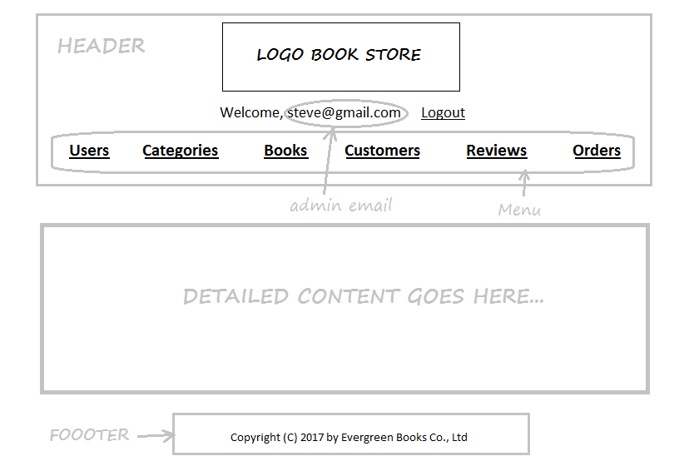
ADMIN PAGE STRUCTURE

Slide 3
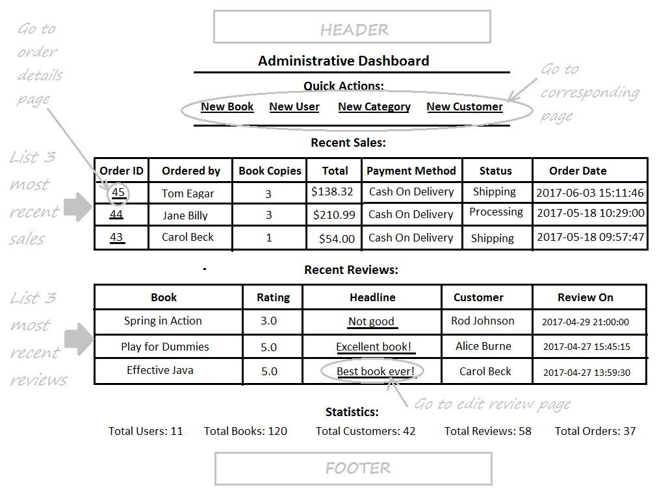
ADMIN HOME PAGE

Slide 4
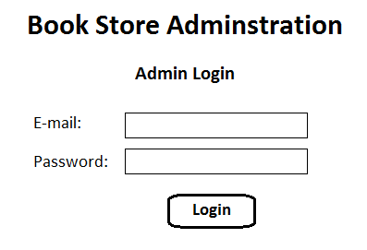
ADMIN LOGIN FORM

Slide 5
USER INTERFACE DESIGN FOR USERS MANAGEMENT
User Listing Page
Create New User Page
Edit User Page
Delete User Confirmation Dialog

Slide 6
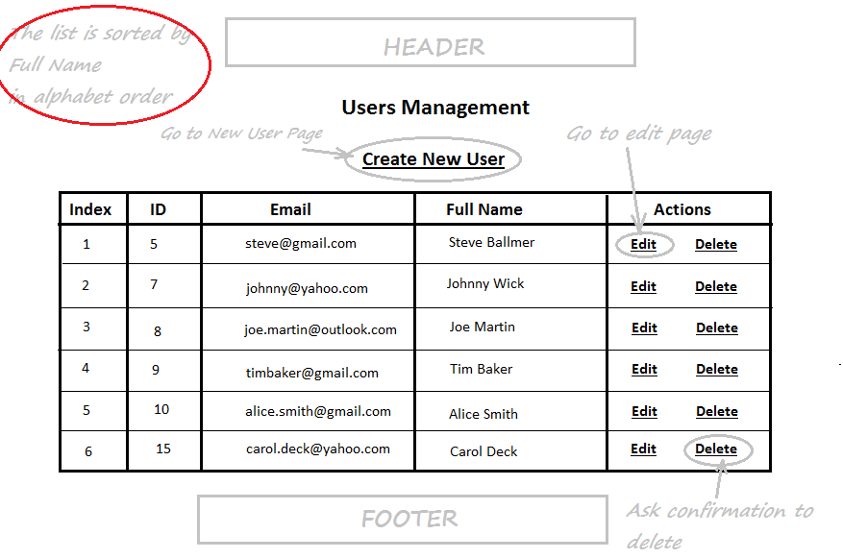
USER LISTING PAGE

Slide 7
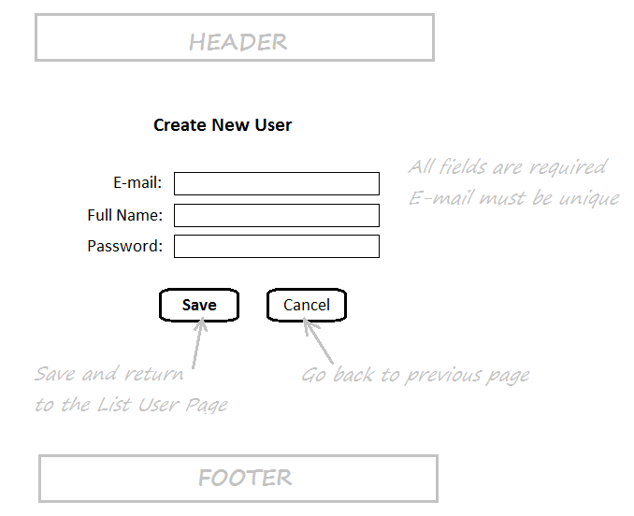
CREATE NEW USER PAGE

Slide 8
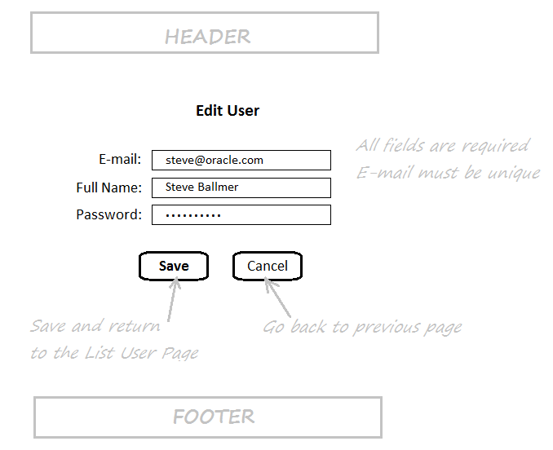
EDIT USER PAGE

Slide 9
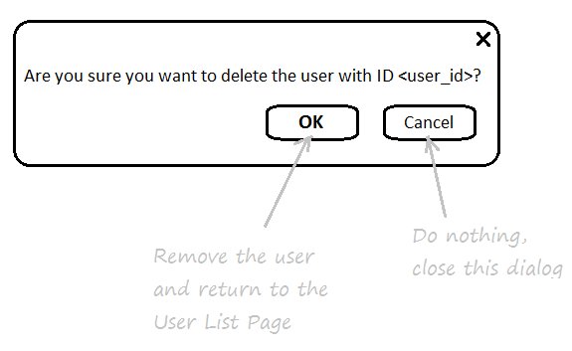
DELETE USER CONFIRM DIALOG

Slide 10
USER INTERFACE DESIGN FOR CATEGORY MANAGEMENT
Category Listing Page
New Category Page
Edit Category Page
Delete Category Confirmation Dialog

Slide 11
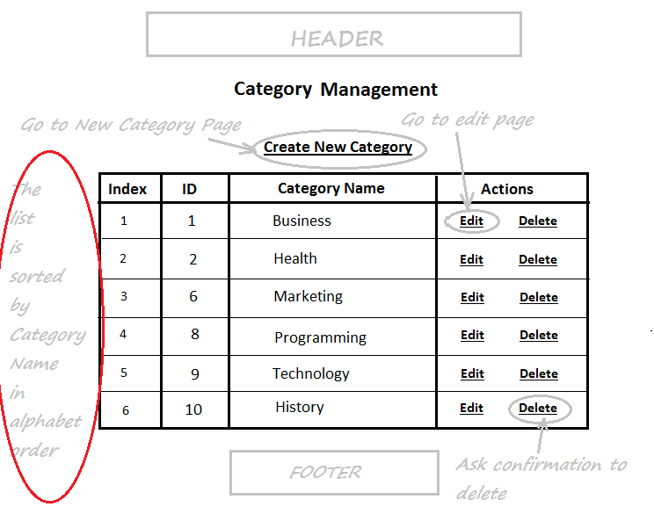
CATEGORY LISTING PAGE

Slide 12
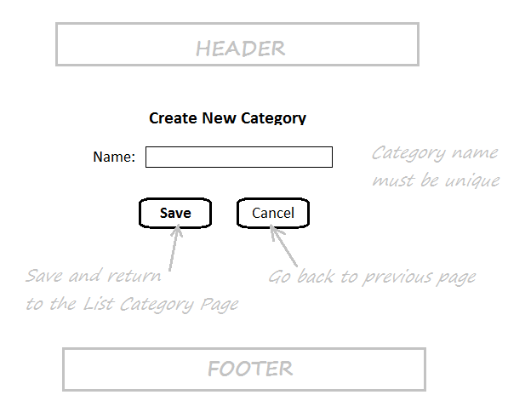
CREATE NEW CATEGORY PAGE

Slide 13
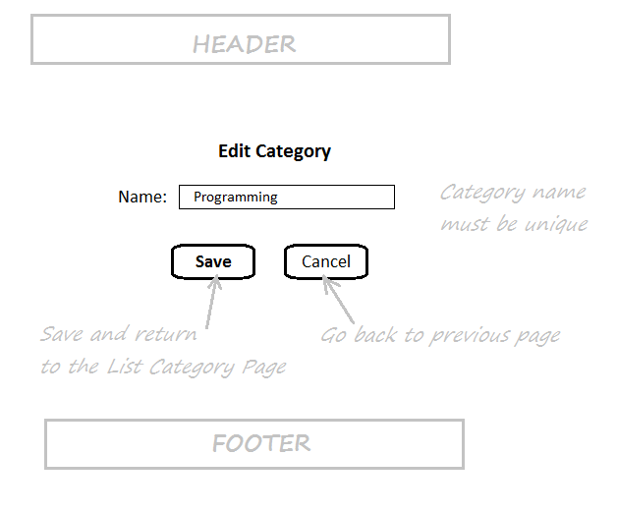
EDIT CATEGORY PAGE

Slide 14
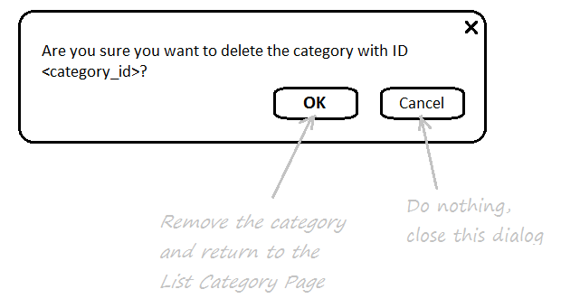
DELETE CATEGORY CONFIRMATION DIALOG

Slide 15
USER INTERFACE DESIGN FOR BOOK MANAGEMENT
Book Listing Page
Create New Book Page
Edit Book Page
Delete Book Confirmation Dialog

Slide 16
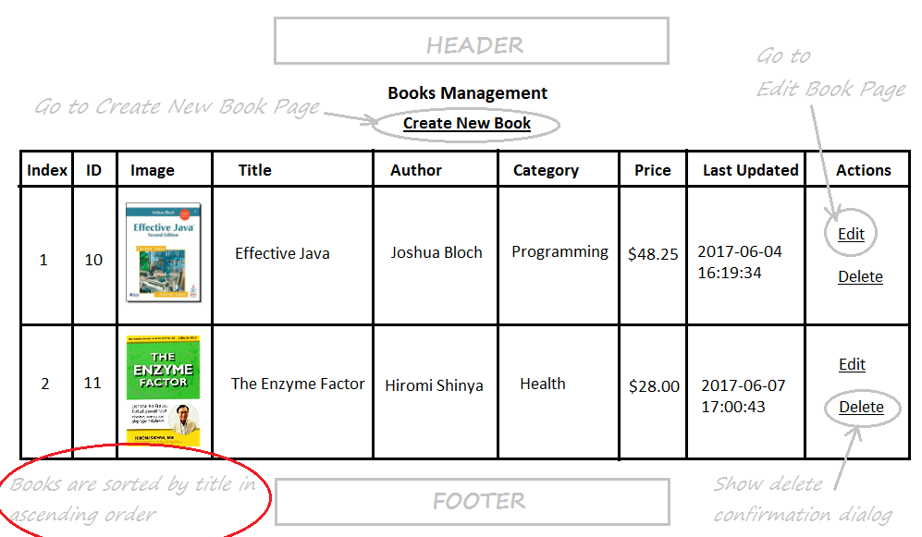
BOOK LISTING PAGE

Slide 17
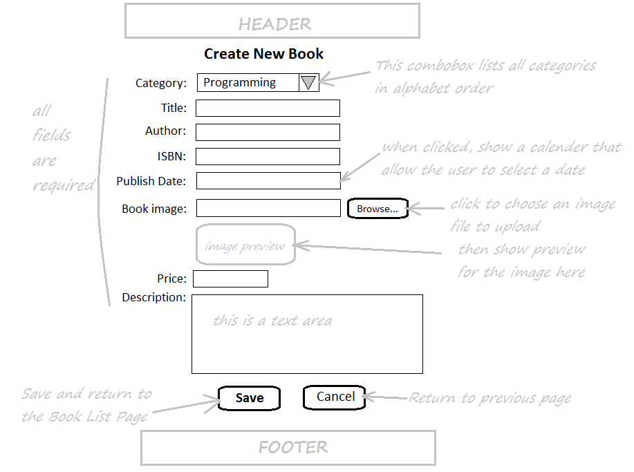
CREATE NEW BOOK PAGE

Slide 18
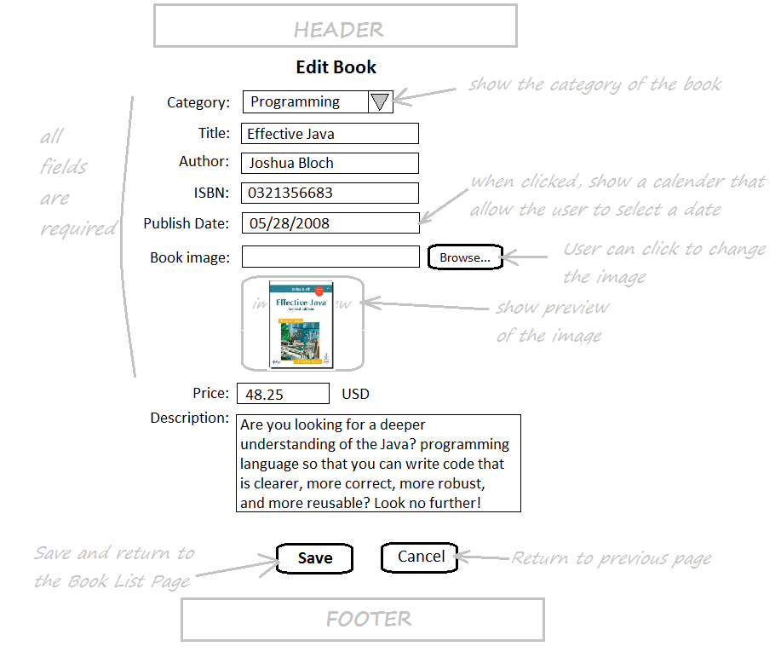
EDIT BOOK PAGE

Slide 19
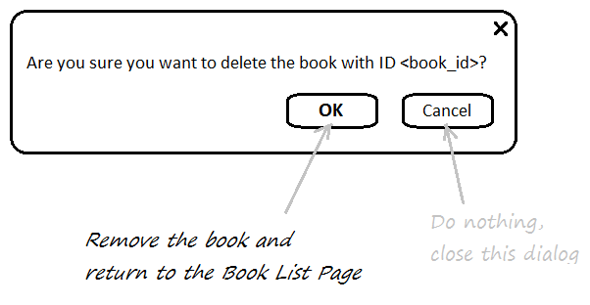
DELETE BOOK CONFIRMATION DIALOG

Slide 20
USER INTERFACE DESIGN FOR CUSTOMER MANAGEMENT
Customer Listing Page
Create New Customer Page
Edit Customer Page
Delete Customer Confirmation Dialog

Slide 21
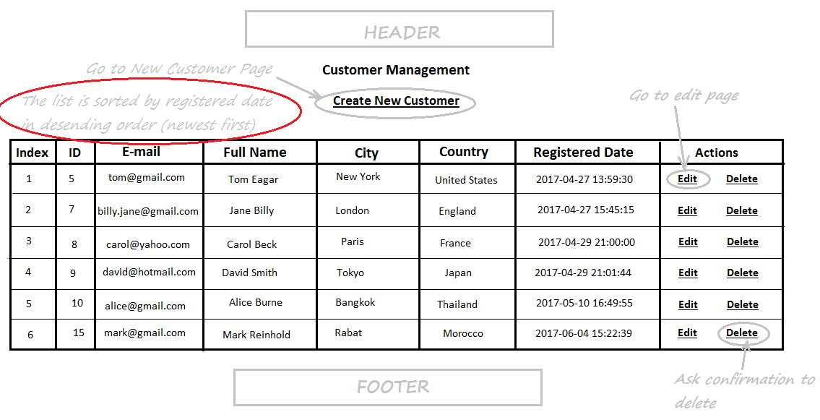
CUSTOMER LISTING PAGE

Slide 22
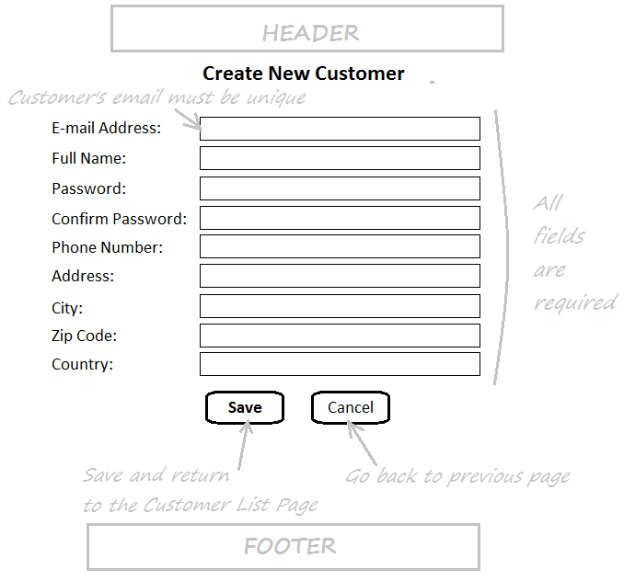
CREATE NEW CUSTOMER PAGE

Slide 23
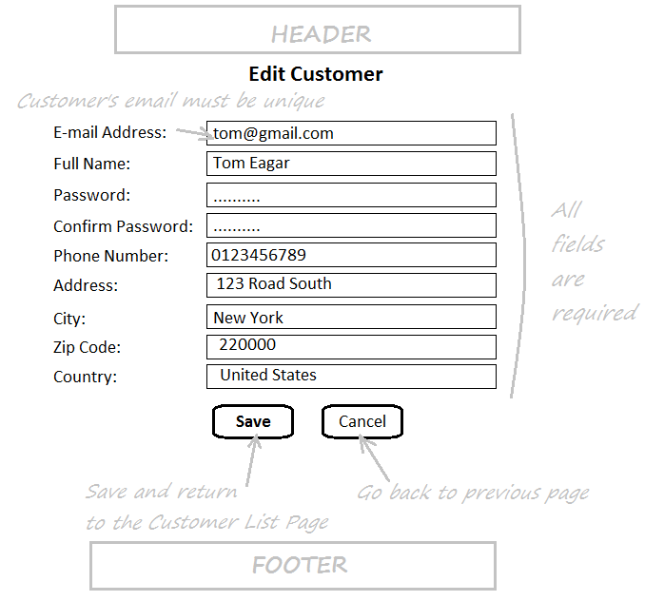
EDIT CUSTOMER PAGE

Slide 24
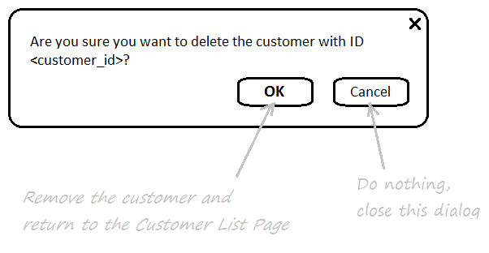
DELETE CUSTOMER CONFIRMATION DIALOG

Slide 25
USER INTERFACE DESIGN FOR REVIEW MANAGEMENT
Review Listing Page
Edit Review Page
Delete Review Confirmation Dialog

Slide 26
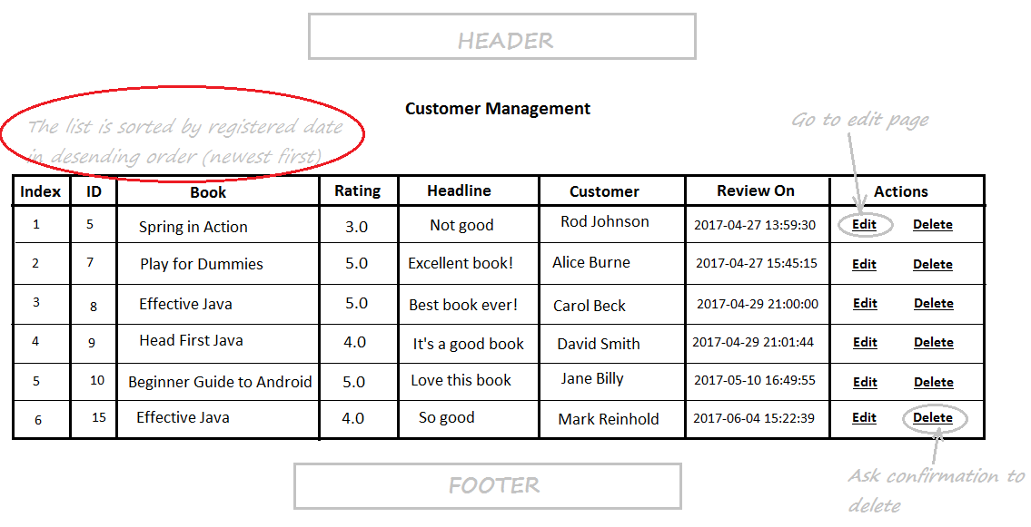
REVIEW LISTING PAGE

Slide 27
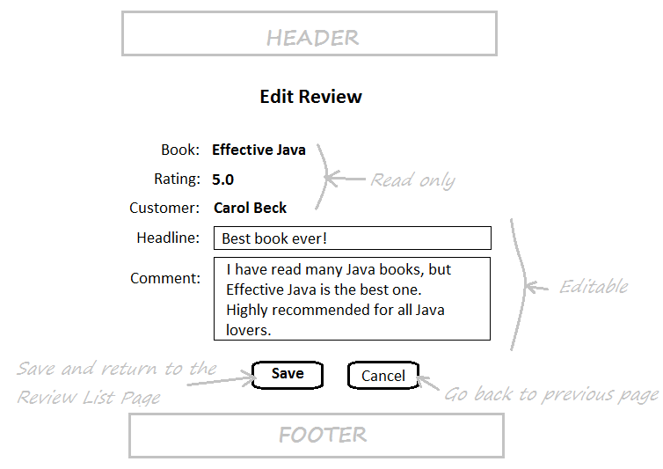
EDIT REVIEW PAGE

Slide 28
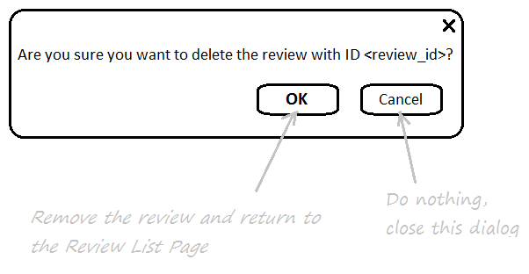
DELETE REVIEW CONFIRMATION DIALOG

Slide 29
USER INTERFACE FOR ODER MANAGEMENT
Order Listing Page
Order Details Page
Edit Order Page
Add Books to Order Popup
Add Book Success Message

Slide 30
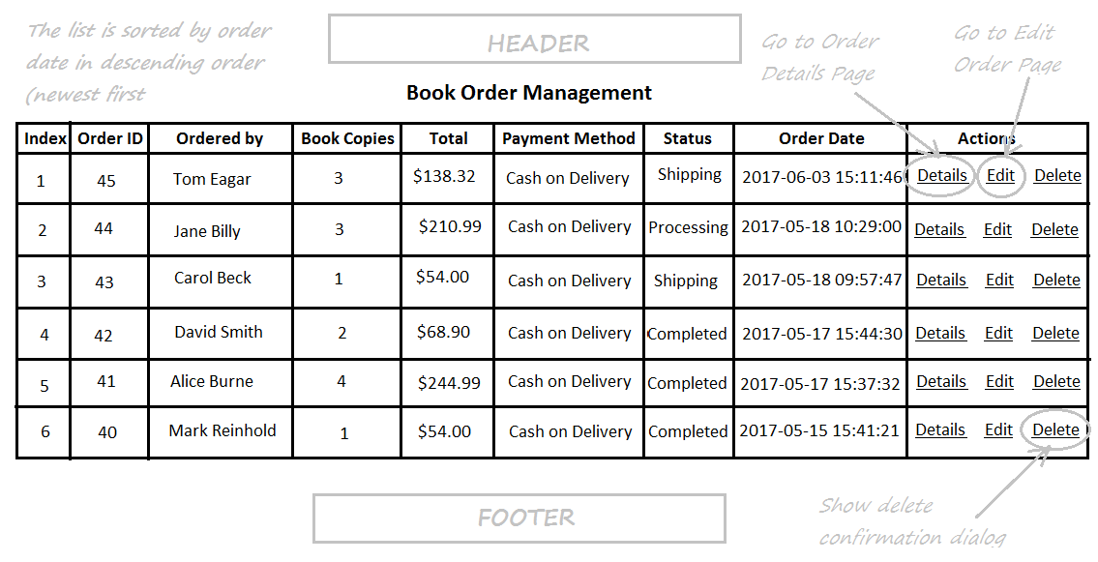
ORDER LISTING PAGE

Slide 31
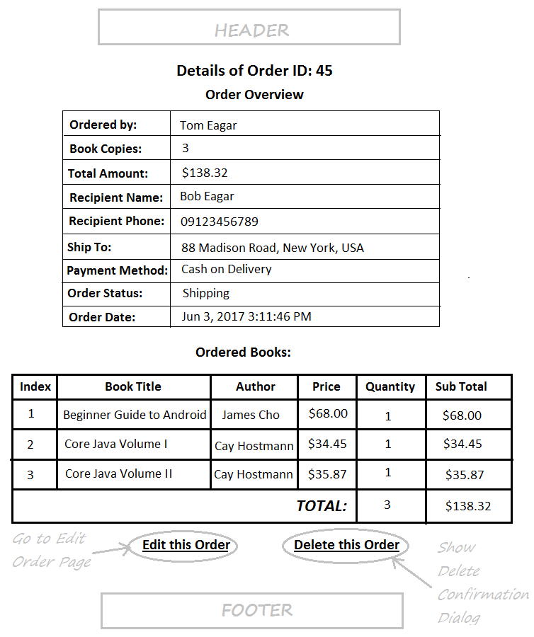
ORDER DETAILS PAGE

Slide 32
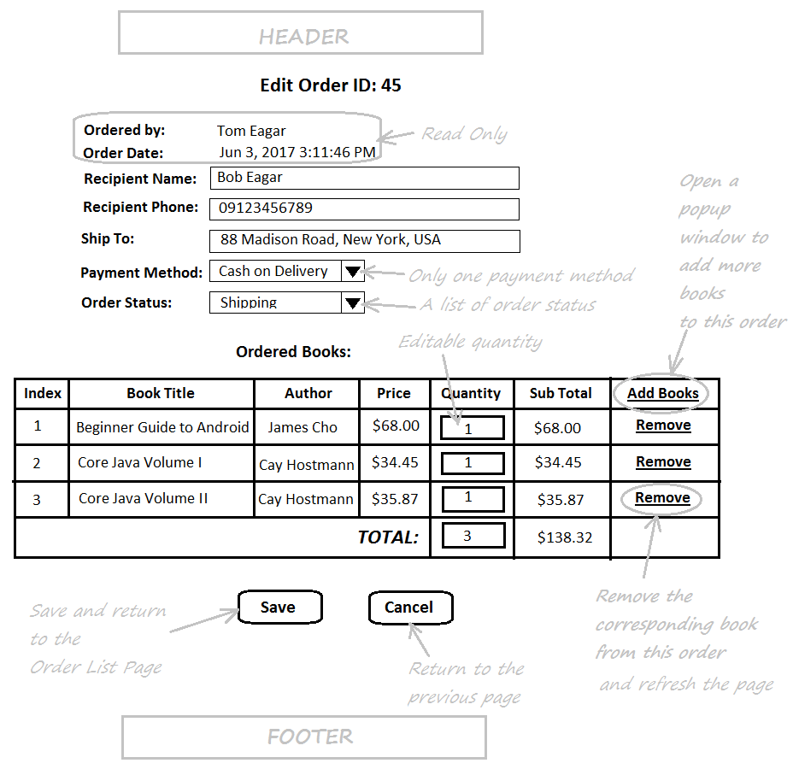
EDIT ORDER PAGE

Slide 33
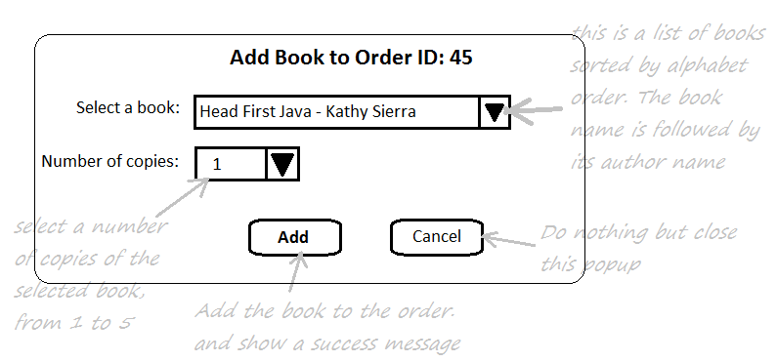
ADD BOOKS TO ORDER POPUP

Slide 34
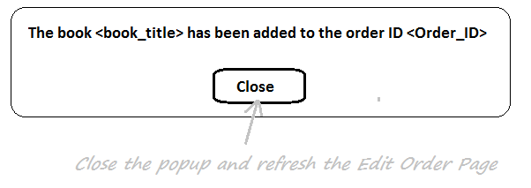
ADD BOOK SUCCESS MESSAGE

Slide 35
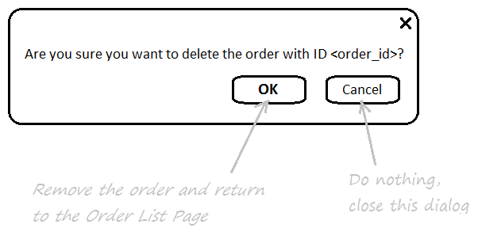
DELETE ORDER CONFIRMATION DIALOG

Slide 36
END

